Slide 1
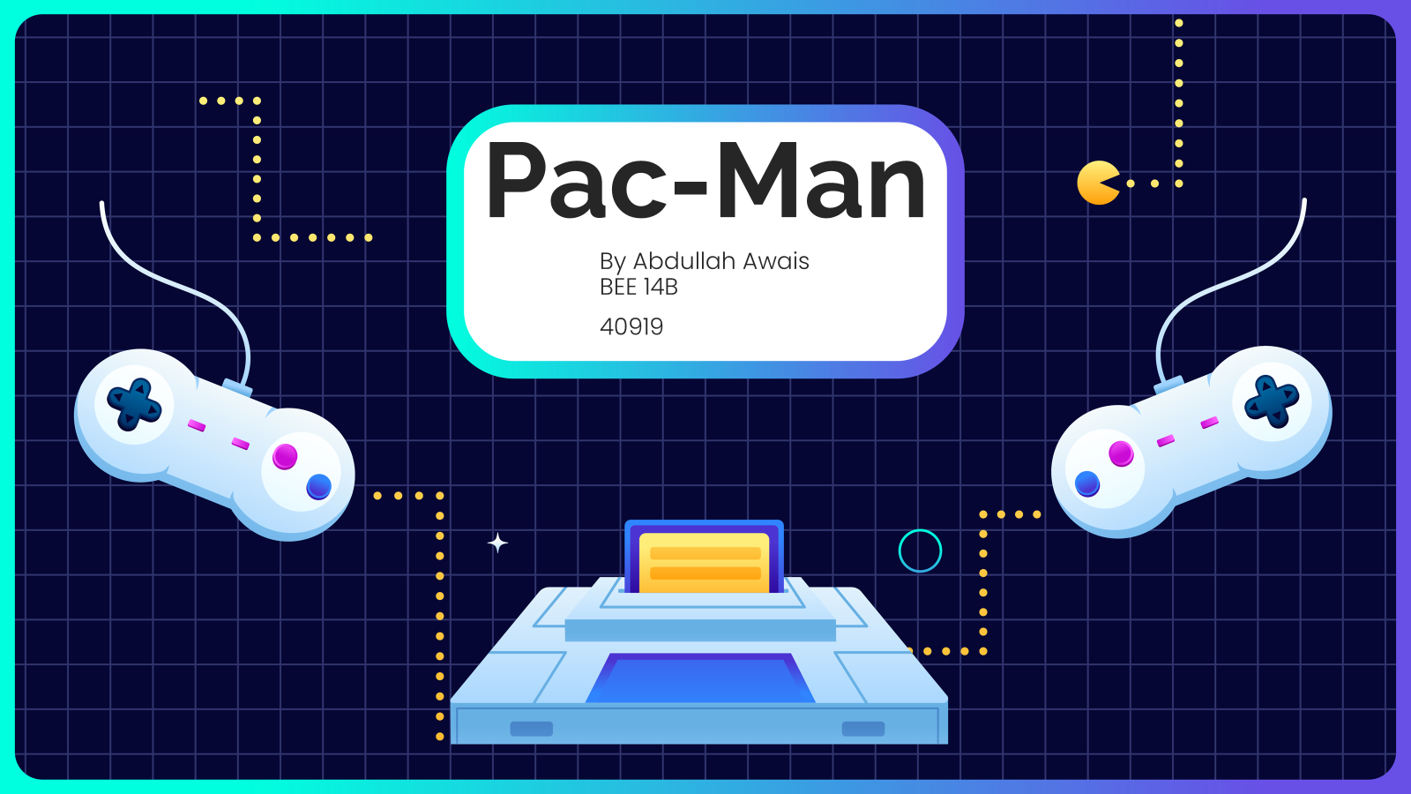

Slide 2

Introduction
Welcome to my immersive journey into the world of Pacman, where classic arcade gaming meets modern Object-Oriented Programming! In this project, we have leveraged the power of C++ and the Simple and Fast Multimedia Library (SFML) to recreate the iconic Pacman experience.
My project is not just a replication of the original Pacman; it's a revival that showcases the principles of Object-Oriented Programming. I have carefully designed and implemented classes, access specifiers, constructors, header files, and file handling to capture the essence of Pacman's game dynamics.

Slide 3

Additional Features
Background Music
Main Menu
Changeable Game Speed
Different Maps
Changeable Pacman Color
Score and High Score

Slide 4
Game UI
Application Start
Main Menu
Game Start
Game Speed Selection
Map Selection
Pacman Color Selection
Exit

Slide 5
Game Logic
Game Starts
Initialization of Variables
Object Creation
Rendering Window
Map Sketching
Ghost Tracking
Direction and Position
Animation Frames
Objects Spawning
State Checking
Score Counting
Level Changing
High Score Storage
State Checking
Window Switching

Slide 6
SFML
C++ Library
Cross-Platform Compatibility
Graphics and Multimedia
Ease of Use
Active Community Support

Slide 7

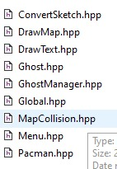
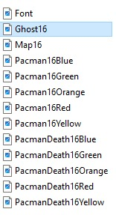
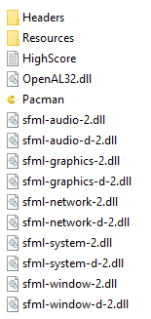

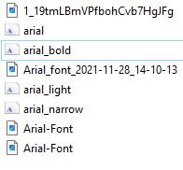
PROJECT TREE

Slide 8



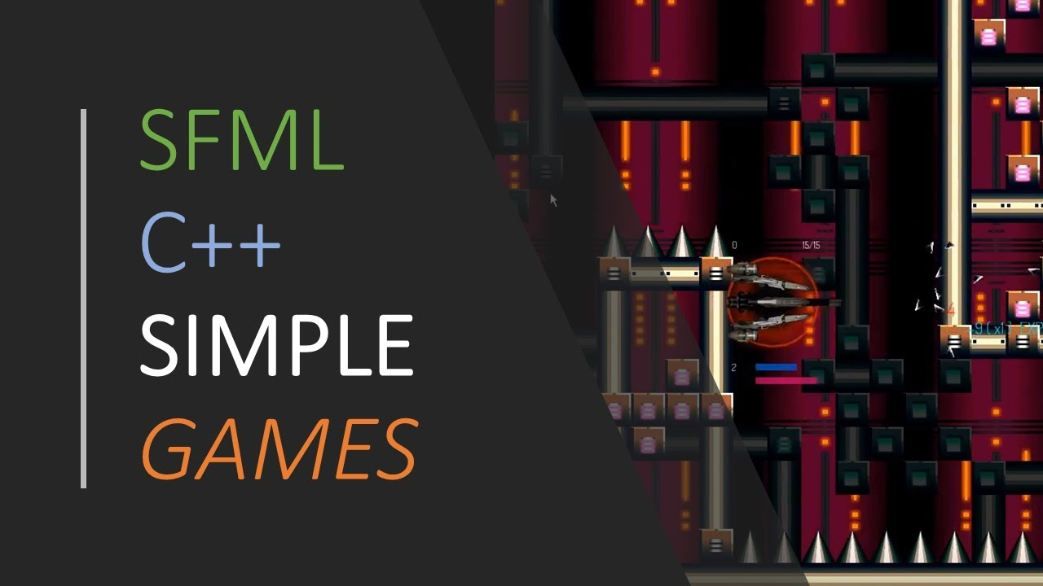
GitHub Link and References

Slide 9
